Slide 1









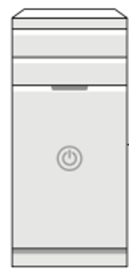

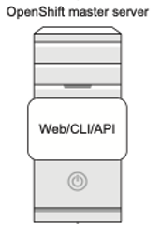



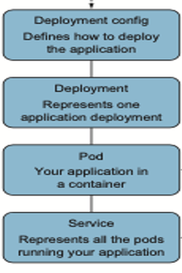
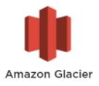
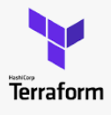




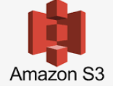

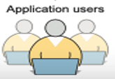
AppW Archive Data Traffic Flow and Authentication
Citizens Internal network
Cloud
VPC
Consumer account
Security account
Shared Services
Subnet 1
Subnet 2
Jump Server
CI/CD Pipeline
AWS services
Routing Layer
with Load balancer
PaaS OpenShift Cluster
Citizens Internal network

Slide 2
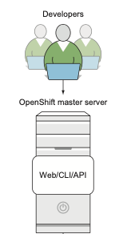
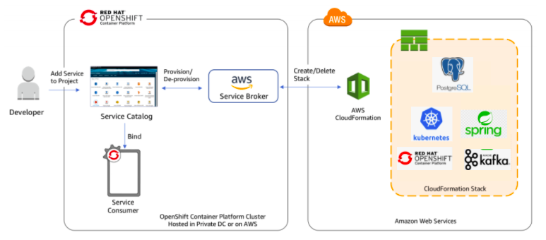
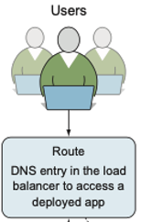



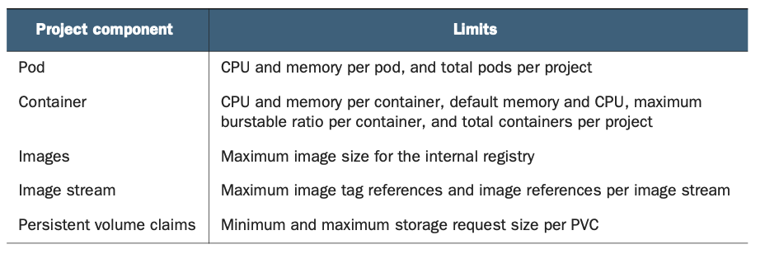
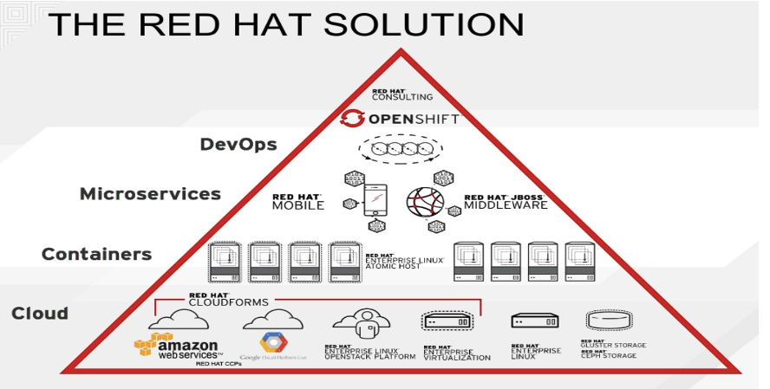
Setting up VPC endpoints for AWS CloudFormation
A route is created in the software load balancer to provide consistent application access using DNS
All of the Pods are proxied through the service, which allows for easier pod scaling

Slide 3
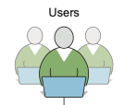


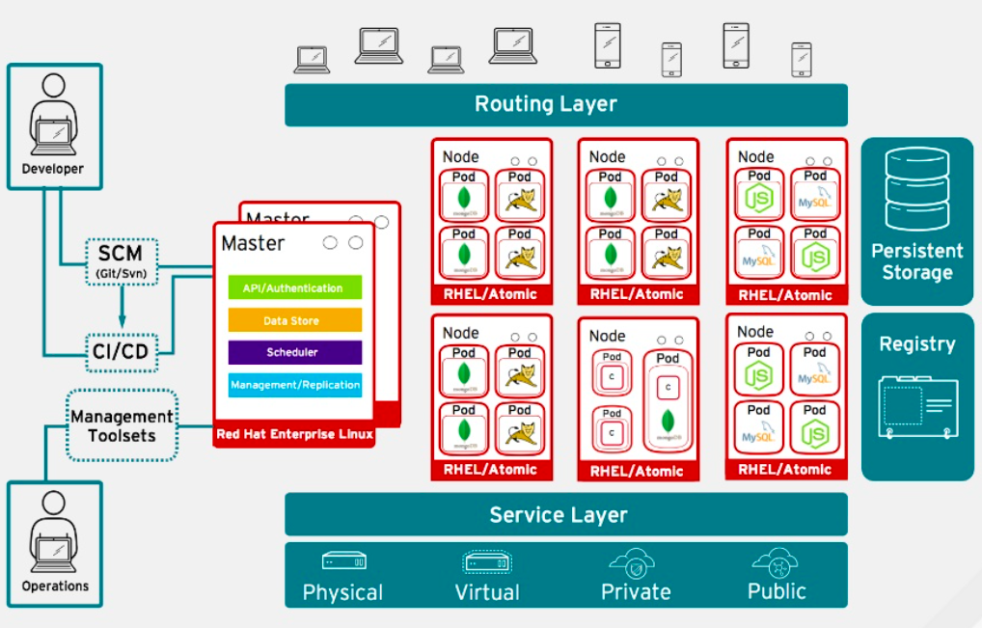





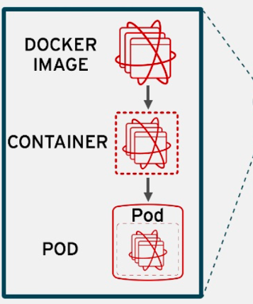
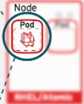



Routing Layer – provides easy DNS access and a consistent endpoint for all application in VPC
Register - provides container images to build and deploy application on the node
Service Layer – encapsulates the application’s business logic and coordinating responses
Eureka Server
Config Server
Single SignOn
ACL
Zuul
Bitbucket
PostgreSQL Database
Image
CONSUL

Slide 4

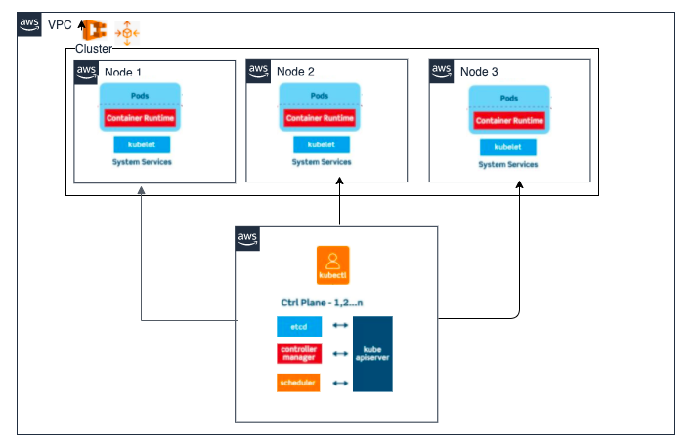




Ingress Approach for P1/P2/P Environment
K8 Cluster Pod (DB Internal Service) to Remote RDS Storage
PostgreSQL
Storage Requirements
Storage does not depend on pod life cycle
Storage must be available on all nodes
Storage needs to survive even if cluster crashes
PostgreSQL-user
PostgreSQL-pwd
Stateful Set
Volumes
DB Handler
Port: 9000
10.2.2.5
Internal Service
Deployment.yaml
External Service
ClusterIP
10.128.8.64
3200
Ingress
Secret
ConfigMap
ClusterIP
10.128.18.6
27001
DB_USER=PostgreSQL-user
K8s Components includes
1 Pod
2 Service
3 Ingress
4 Volumes
5 ConfigMap
6 Secrets
7 Deployment
8 StatefulSet
K8s creates Endpoint object (Service) that keeps track of which Pods are members/endpoints of the service
DB_USER=PostgreSQL-pwd
DB_URL=PostgreSQL
Secret:
1. used to store secret data
base64 encoded
The built in security mechanism is not enabled by default

